Slide 1
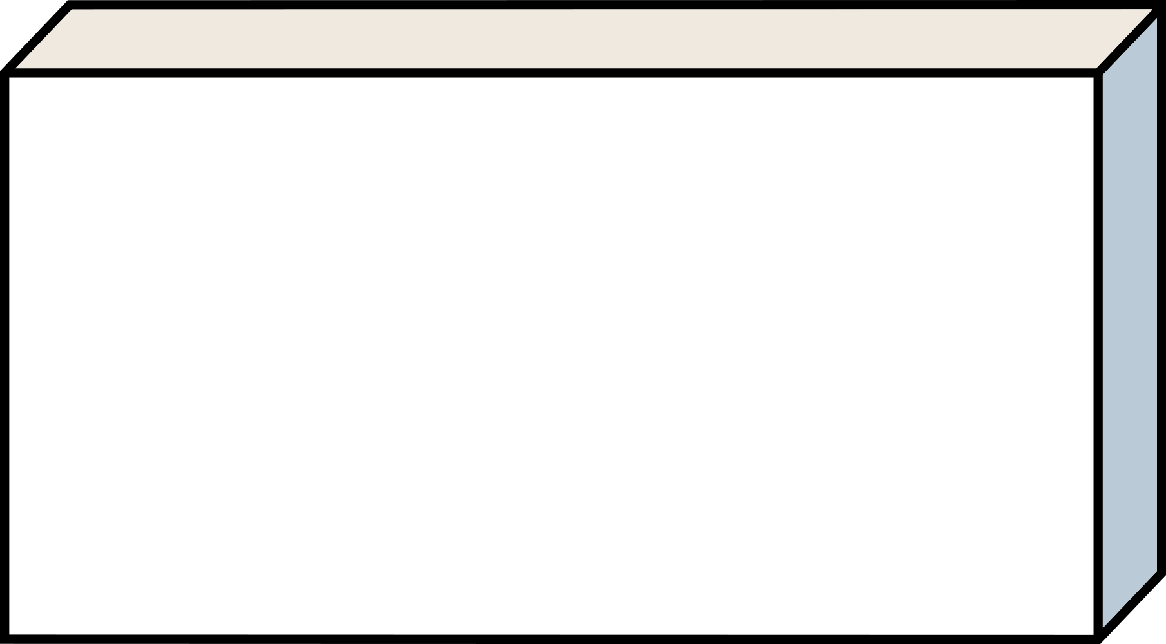



RNA Virus
Presentation
2016038003 Chanjin Lee 2016038019 Juhyeong Jung 2016038022 Junho Choi 2016038034 Hyuk Kim
Group
Fossil or human?

Slide 2



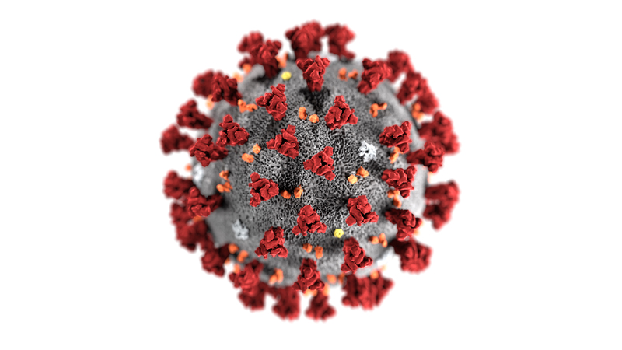

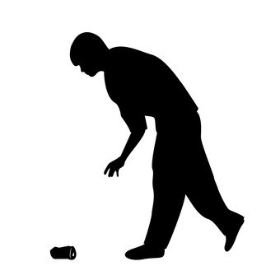


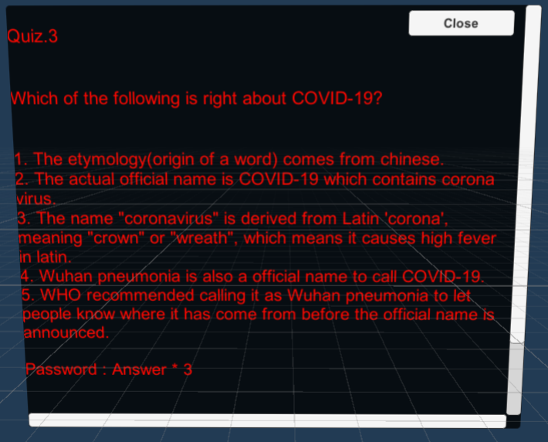
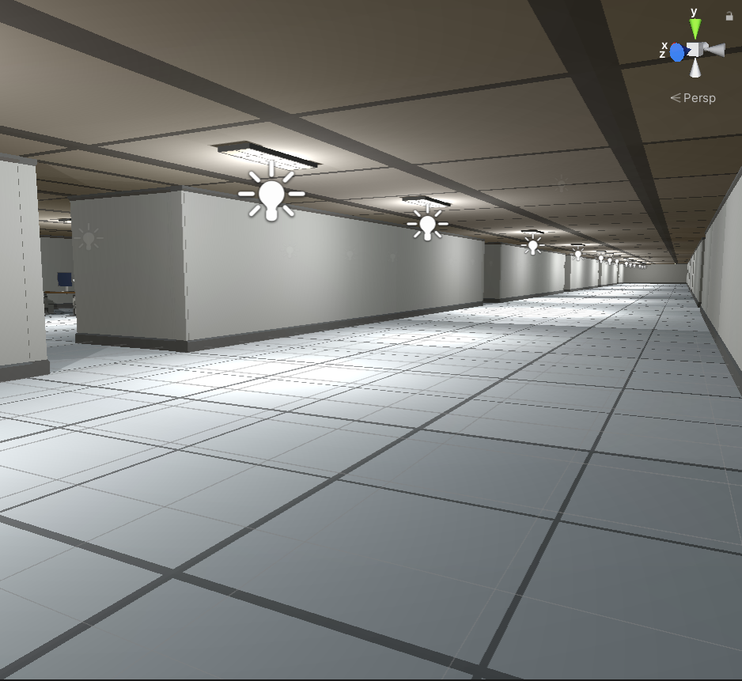
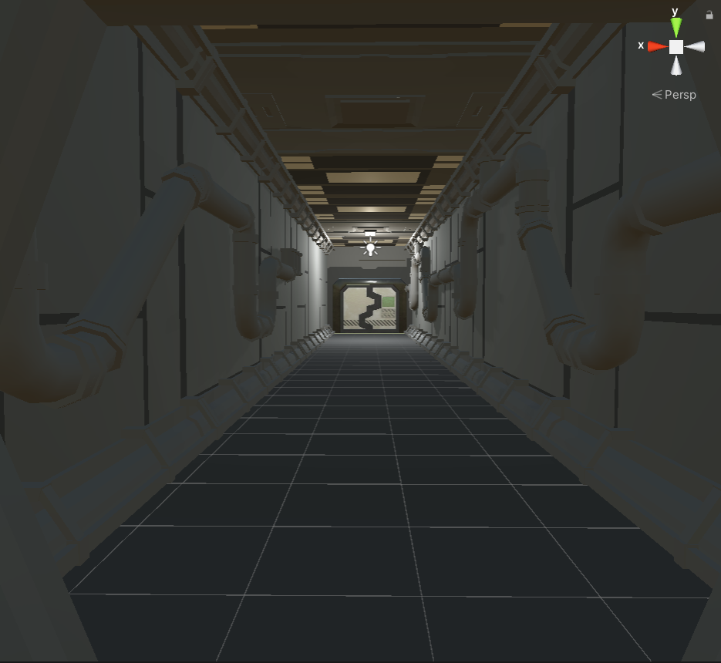
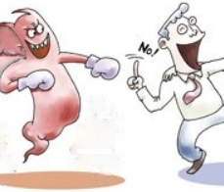
Although it is a medical game, it added fun so that everyone
can enjoy it.
At the end of the game, you can get knowledge by solving a quiz about viruses, and through this, you can grow game items so that you can not only enjoy stage clearing but also enjoy growth..
Background & Purpose
Concept & Idea
The game has a tense atmosphere because it aims to raise awareness about viruses.
Corona is quite popular these days. Although this virus has the greatest influence, in fact, this type of virus has been popular before.
SARS, MERS, measles and Japanese encephalitis viruses are all RNA viruses like corona. Like this, the RNA virus has occurred many times before, and this type of virus will continue to occur. And because the RNA virus appears to be in a modified state, it is very difficult to develop vaccines, especially for ordinary people to carry around. For this reason, individuals should try to 'prevent' viruses. Preventive measures against viruses are easy and simple, but I planned the project with the idea that I would be better able to deal with them if I understood them and had the awareness that they could happen in the future.
Design & Functions
The process of learning about viruses while playing goes through four steps below.
Our game is 3D, so it is more immersive than other games. And you can cultivate your knowledge through more in-depth quizzes.
Follow a map Collecting Quiz Next stage
In-depth Quiz 3D
Future works
Fighting the virus.
Supports a broad map.
Provide information about multiple viruses.
Add Stage and various quizzes

Slide 3
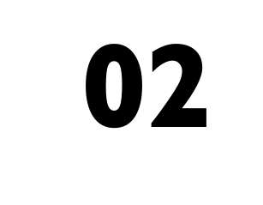




Flow Chart
Follow a map Collecting Data Quiz Next stage

Slide 4
Flow Chart
Follow a map Collecting Data Quiz Next stage

Slide 5
Flow Chart
Follow a map Collecting Data Quiz Next stage

Slide 6
Flow Chart
Follow a map Collecting Data Quiz Next stage

Slide 7




Open Source
ㅇ

Slide 8
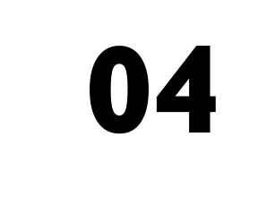


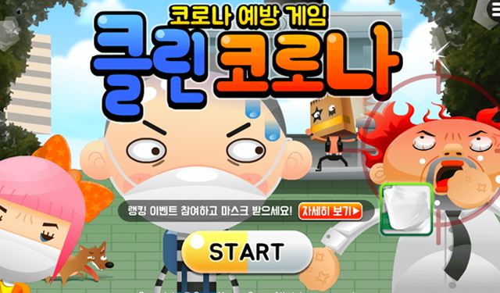





Related Works

Slide 9

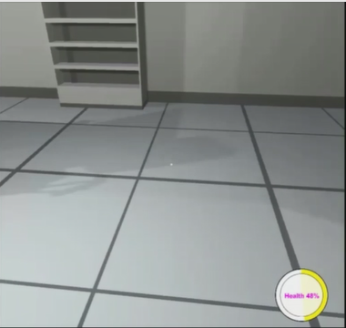


Differentiation
1. Dark Atmosphere Formation

Slide 10
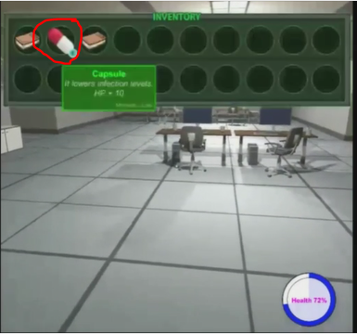
Differentiation
2. Items Helping Survive

Slide 11
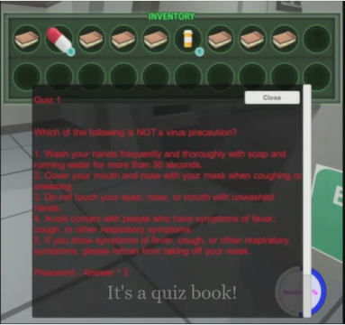
Differentiation
3. Medical Purpose through Quiz

Slide 12
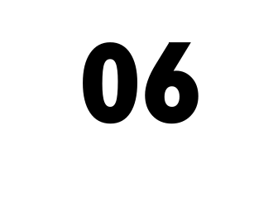
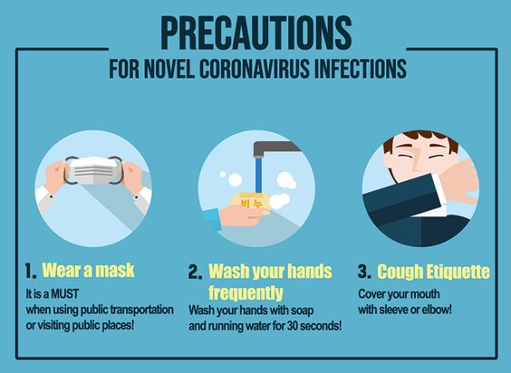

Expected Effects
1. Tips for prevention

Slide 13
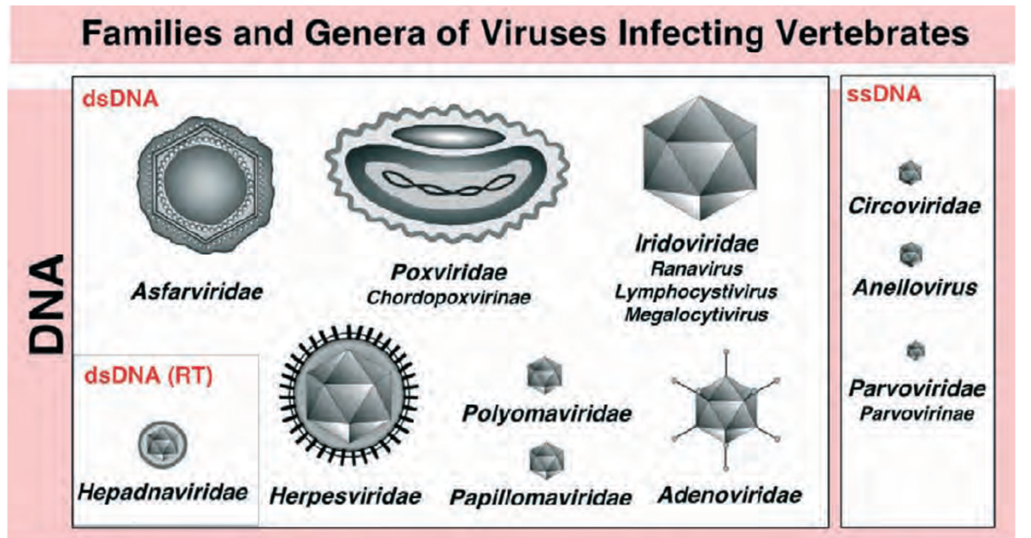
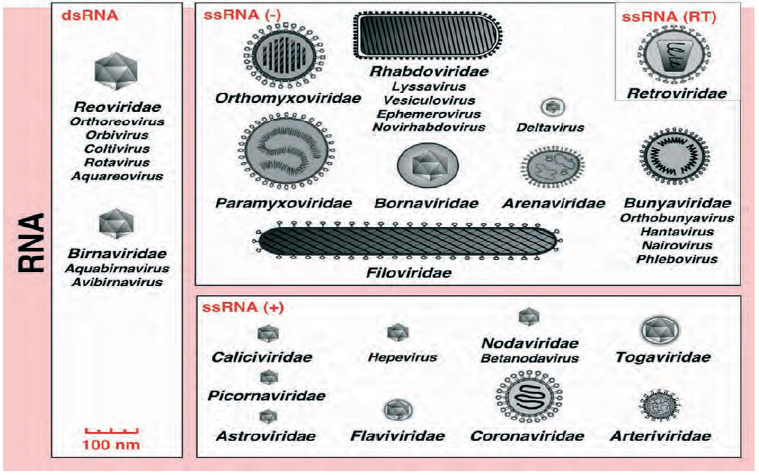
Expected Effects
2. Alertness, Knowledge

Slide 14



